Slide 1
User Research
Update
Group 1, Homodeus

Slide 2
AGENDA
Surveys
Interviews
Transcripts
Persona’s
User scenario
Empathy mapping
Manifesto’s

Slide 3

MOST IMPORTANT DATA:
60%
What occupation do most people have? Work full-time/study
LOCATION
We handed out our survey at the Rembrandt gallery of Eindhoven
We received about 20 replies
30%
Are people interested in buying art? At some point, yes
OF PEOPLE ENJOY ART ONLINE
40%
What art are most people interested in? Paintings/Digital art
30%
Where do people enjoy art the most? Online
60%

Slide 4
INTERVIEWS
Interview Erion
Transcript
Requirements
- possibility to add pictures
- no catalog, more of a gallery
- avoid warm colors and violet
Interview potential user
- showing prototypes

Slide 5
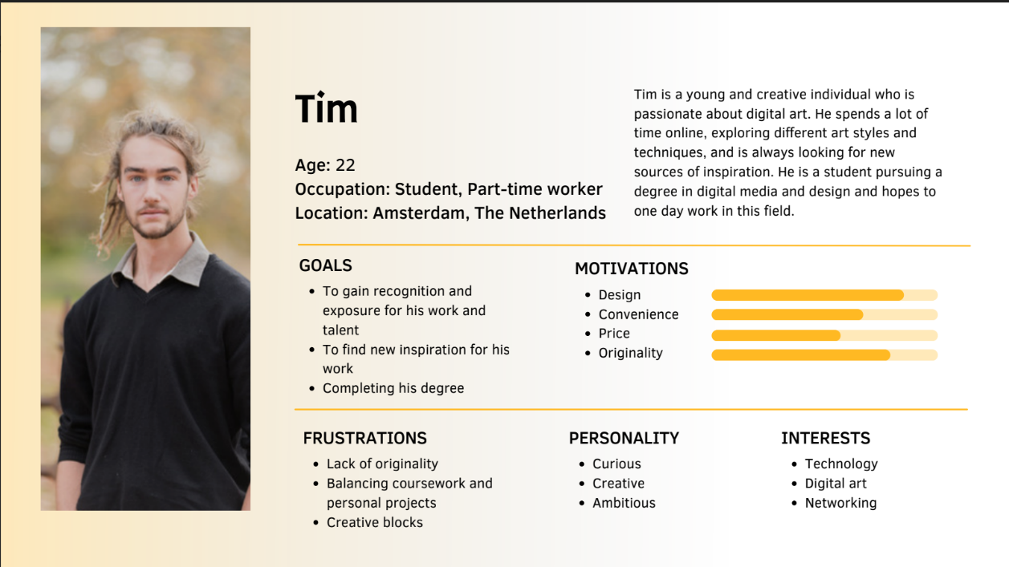
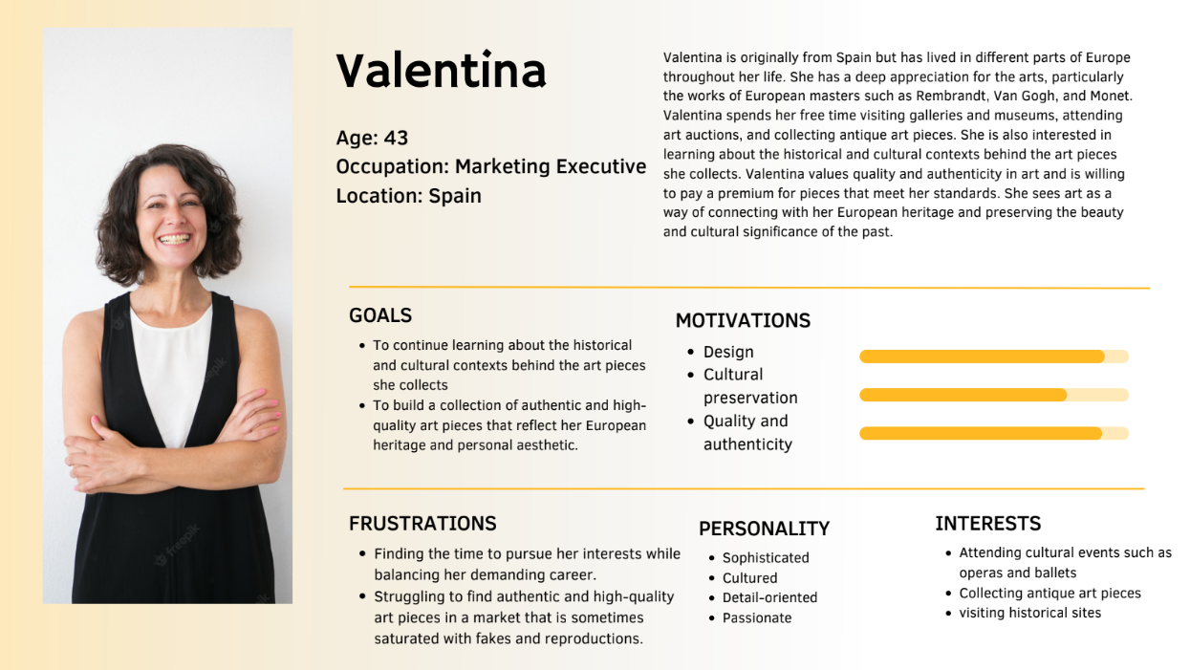
PERSONA’S
Constructed on survey data/interviews
Representing 2 big groups
Students and professionals
Mainly prefer to look and buy art online

Slide 6
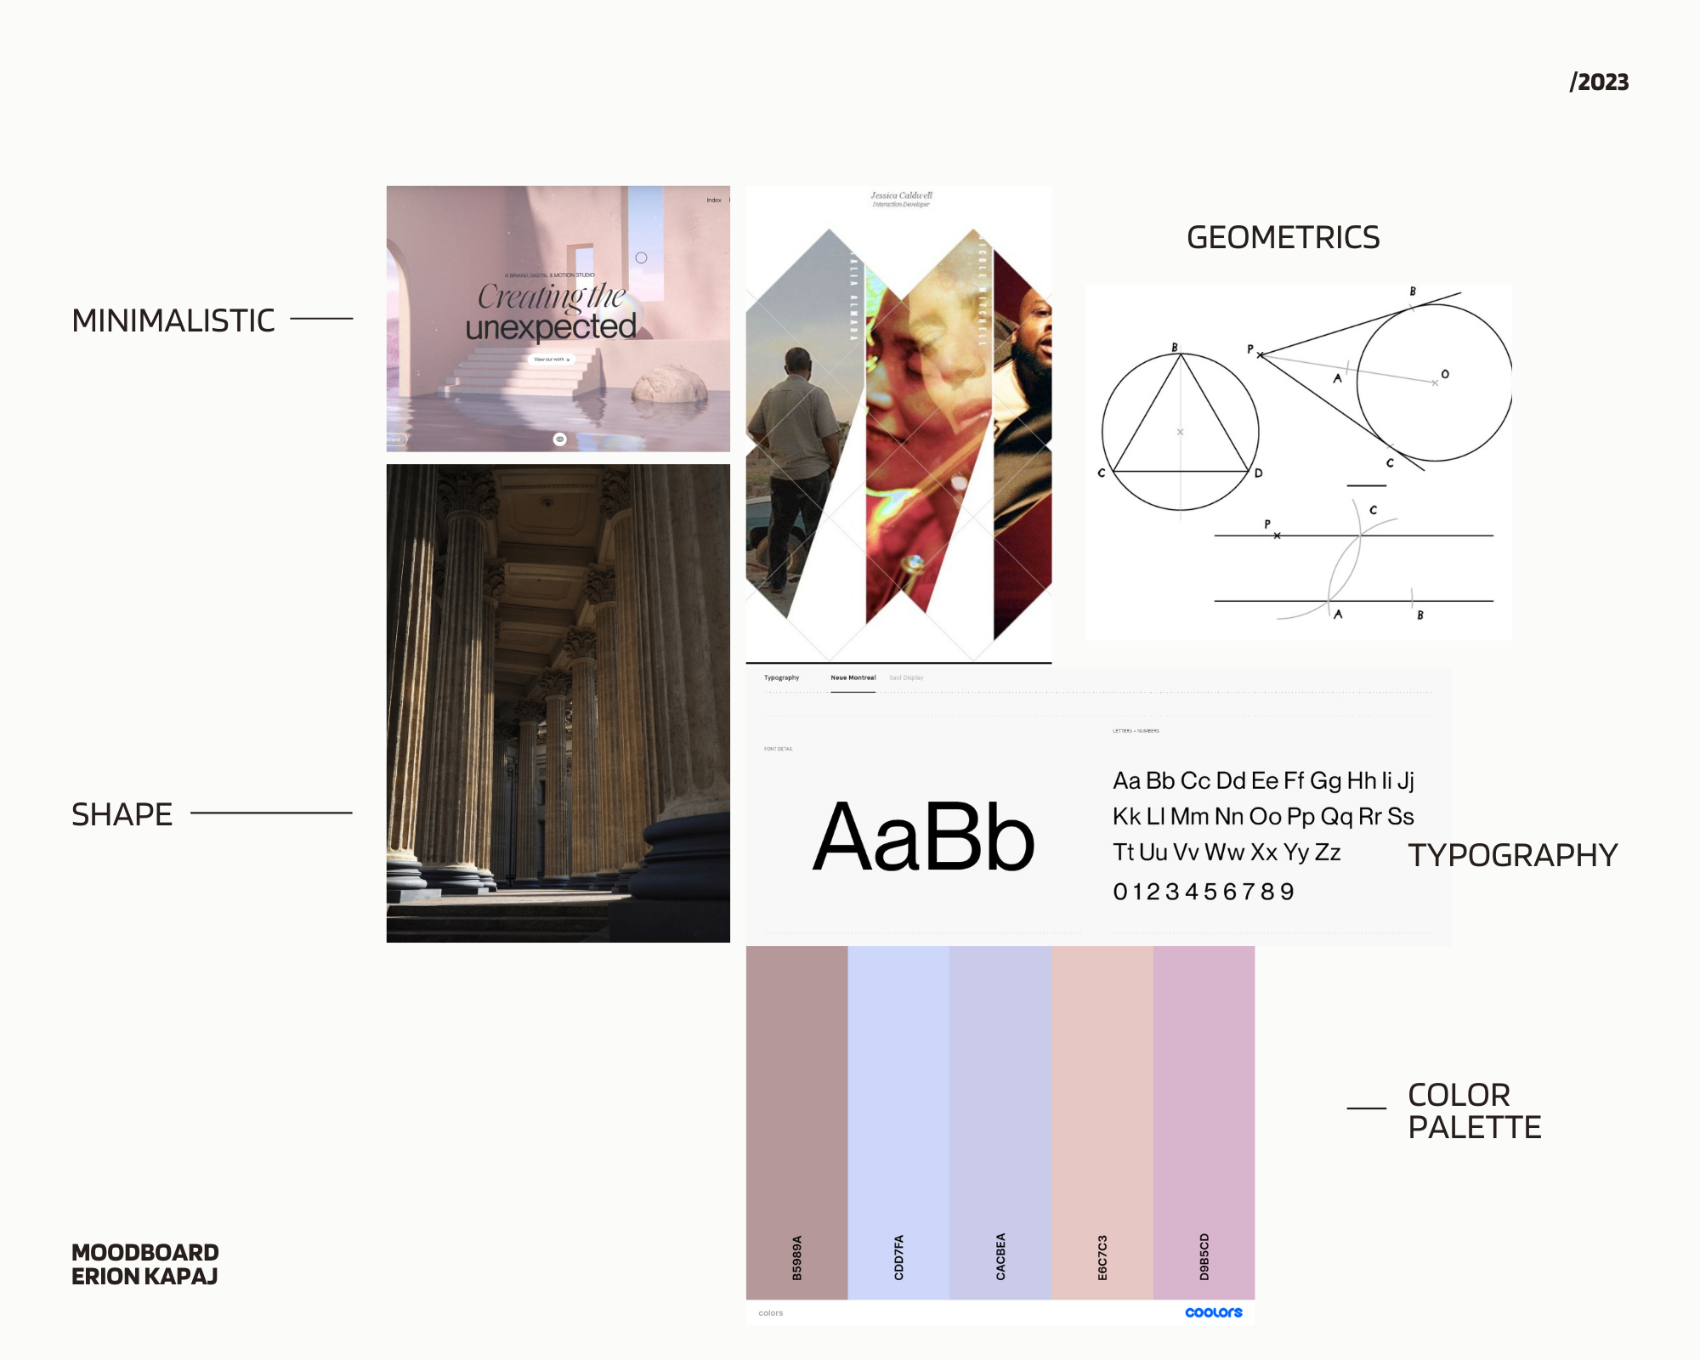
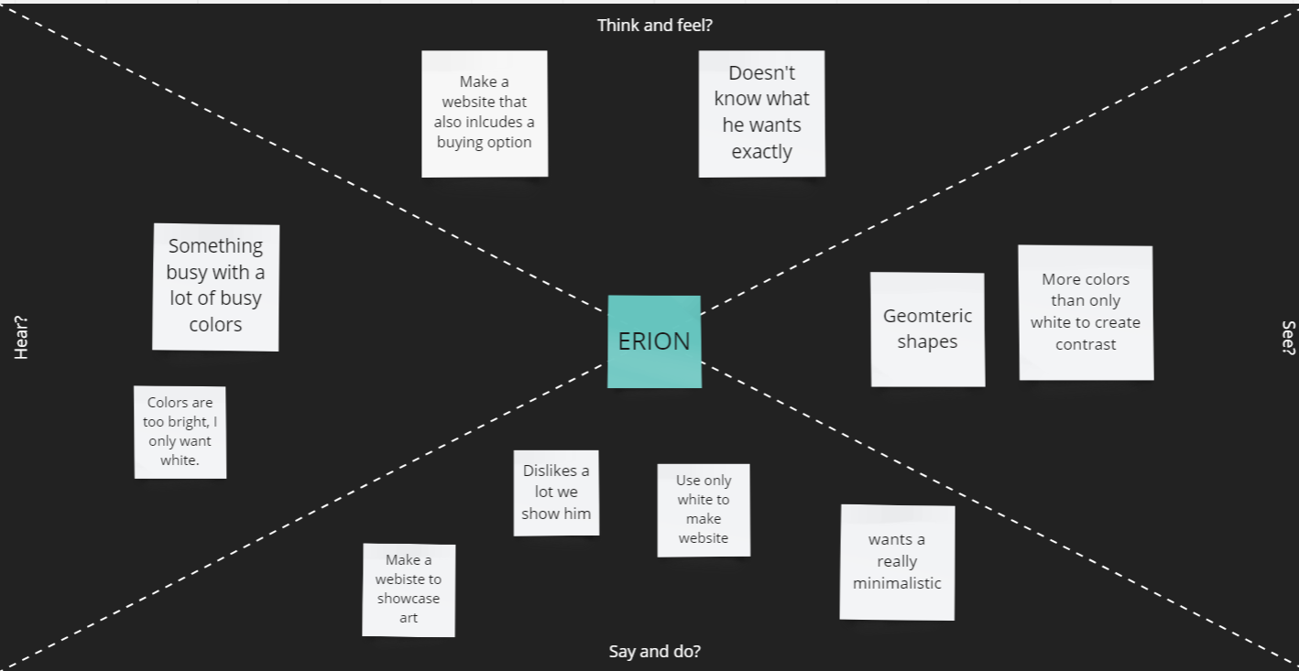
EMPATHY MAPPING/
MOODBOARD
Map created for Erion

Slide 7
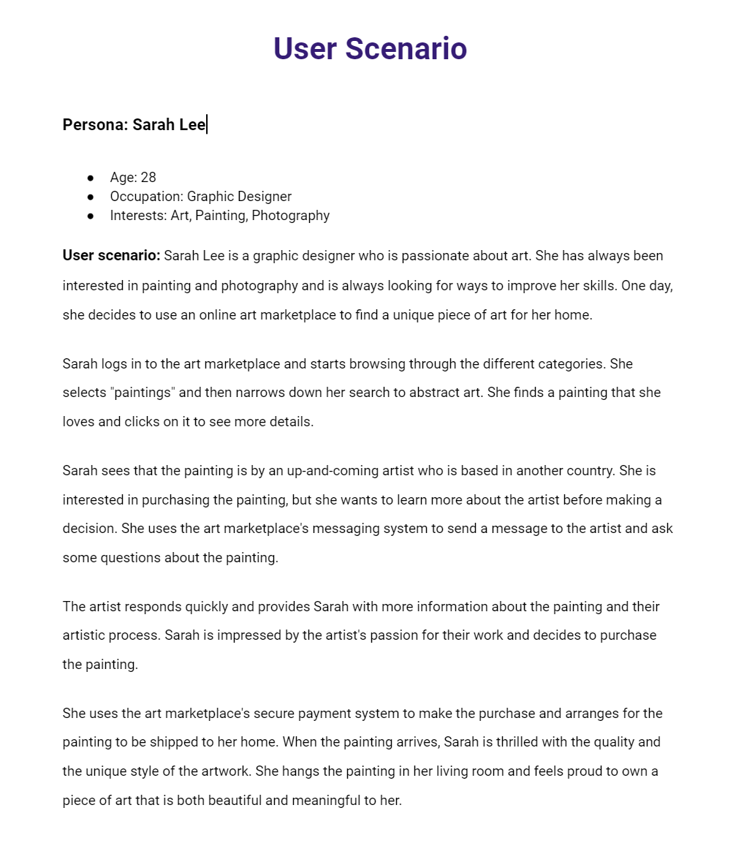
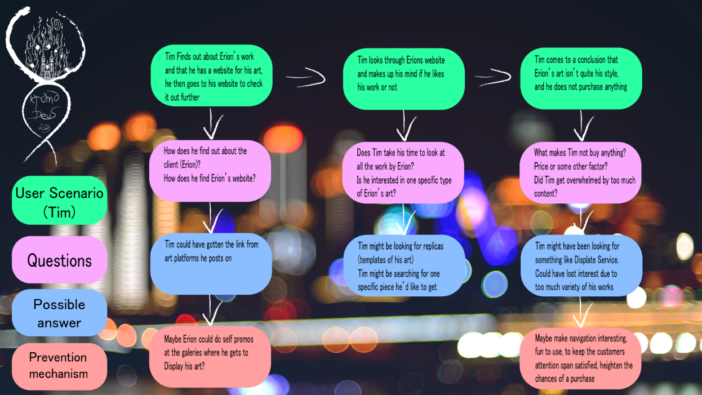
USER SCENARIO/STORY
Tim and Sarah’s journeys, based on first persona

Slide 8
MANIFESTO’S
We created 3 manifesto’s
Here’s to Homodeus, The designers. The students. The workaholics. The ones who do things differently. You can praise us, disagree with us, quote us, disbelieve us, glorify us or vilify us. About the only thing you can’t do is ignore us.
Because we change things.
We are designers.
We create art on the screen.
We will gasp you with our work.
And we will let the world know.
It starts with a thought, it becomes an idea,
It starts with an idea, it becomes a suggestion,
It starts with a suggestion, it becomes a decision,
It starts with a decision, it becomes a implementation,
It starts with an implementation, it becomes a website.
We always start our thoughts for you.

Slide 9

Thanks for listening!

